Slide 1
Progress Report
QIAN Zhiqiang & ZHAO Zihao
2020.11.26

Slide 2
Outline:
Data preprocessing and analysis
Use two mechine learning algorithms
Meet some problems

Slide 3
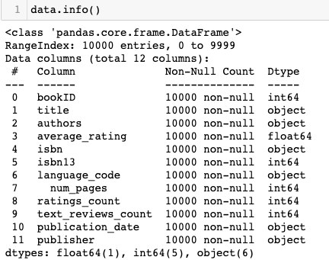
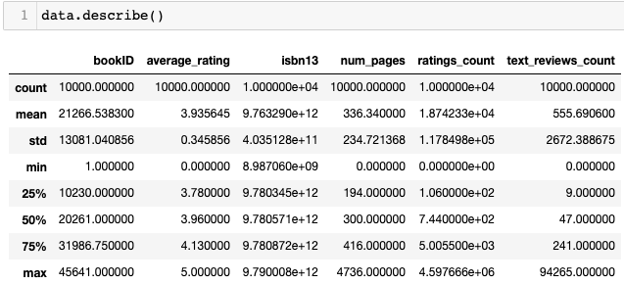
Data preprocessing and analysis
step1. Read relevant dataset and set 'utf8' encode
step2. Description of data
No missing value
There's no negative value

Slide 4
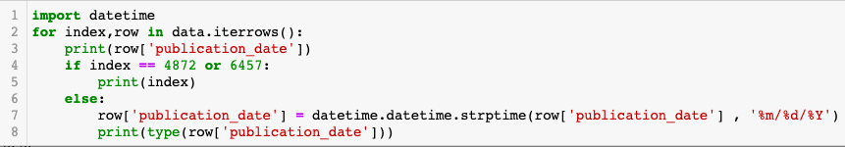
Data preprocessing and analysis
step3. Time format processing----Converts strings to timestamps
There are two lines of data with problems:
index | original record | new record
4874 | 6/31/1982 | 7/1/1982
6459 | 11/31/2000 | 12/1/2000

Slide 5
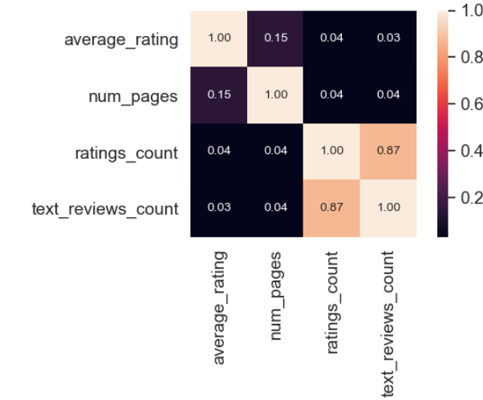
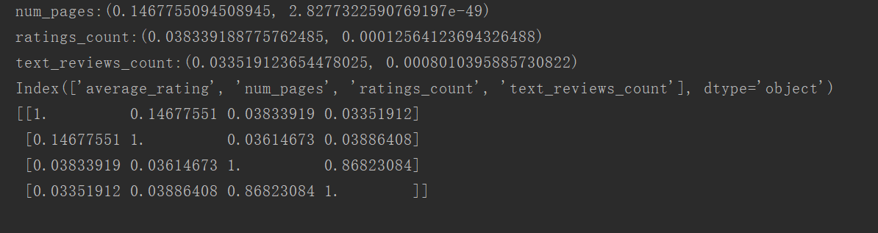
Data preprocessing and analysis
step4. Features analysis

Slide 6
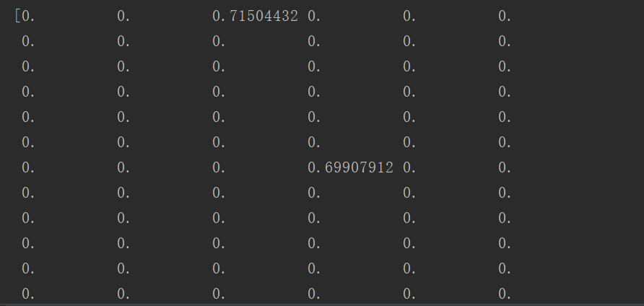
Data preprocessing and analysis
step4. Features analysis

Slide 7
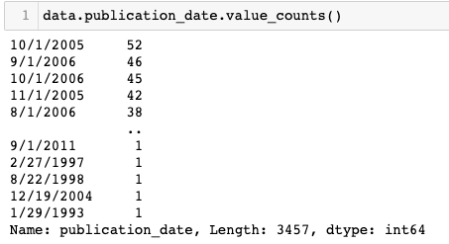
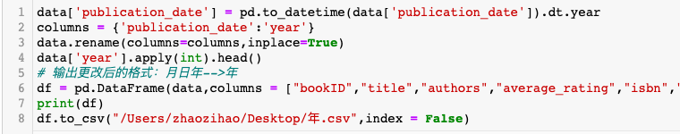
Data preprocessing and analysis
step5. Data visualization
month/day/year--->year

Slide 8
Data preprocessing and analysis
step5. Data visualization

Slide 9
ML algorithm----RandomForestRegressor
Decision Tree
DT Classifier--gini,entropy
how to find the most suitable feature for each iteration?
criterion
DT Regressor--MSE
training dataset--good
testing dataset--poor
overfitting
max_depth
min_samples_leaf
min_samples_split
max_features
min_impurity_decrease
.....
Prune the model

Slide 10
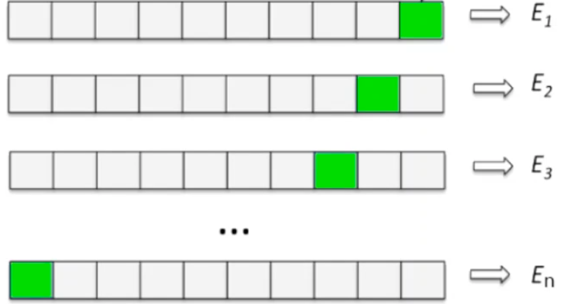
ML algorithm----RandomForestRegressor
Advanced--Cross validation
test dataset
random_state

Slide 11
ML algorithm----RandomForestRegressor
Advanced--Feature selection

Slide 12
ML algorithm----RandomForestRegressor
Decision Tree---Comparison

Slide 13
ML algorithm----RandomForestRegressor
Decision Tree---Comparison

Slide 14
ML algorithm----RandomForestRegressor

Slide 15
ML algorithm----RandomForestRegressor

Slide 16
ML algorithm----RandomForestRegressor

Slide 17
ML algorithm----RandomForestRegressor

Slide 18
ML algorithm----RandomForestRegressor

Slide 19
ML algorithm----RandomForestRegressor

Slide 20
ML algorithm----Support Vector Machine

Slide 21
ML algorithm----Support Vector Machine

Slide 22
ML algorithm----Support Vector Machine

Slide 23
ML algorithm----Support Vector Machine

Slide 24
Next week's assignment：
Continue to optimize the model, pruning the decision tree model
Populate the test data set with the predicted results of the model
Finish the report

Slide 25
Thank you
QIAN Zhiqiang 20098906g
ZHAO Zihao 20092616g

